Slide 1
Cinamin A Perpetual and Nearly Invisible BLE Beacon
Brad Campbell, Josh Adkins, and Prabal Dutta
University of Michigan
bradjc@umich.edu
NextMote Workshop
February 15, 2016
Graz, Austria

Slide 2

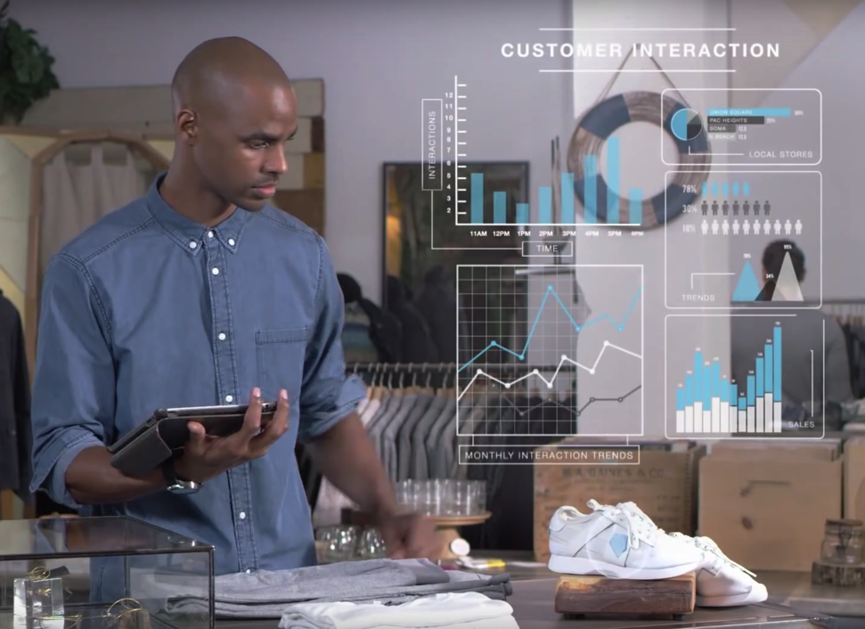

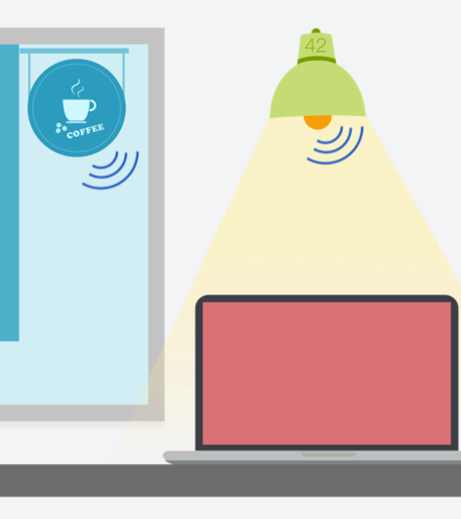

What could we do with tiny Bluetooth Low Energy beacons that we could affix to everything?

Slide 3

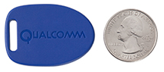
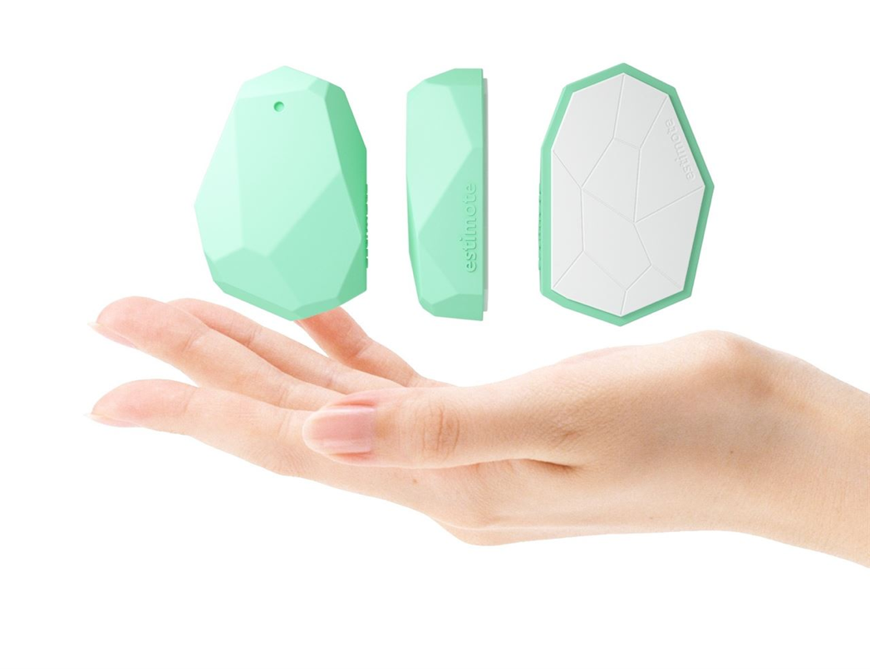
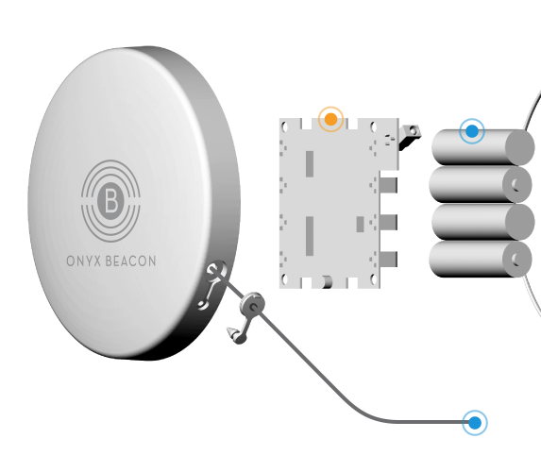
Existing BLE beacons are too big and have limited lifetimes
Size is dictated by the battery
Sufficient for certain applications
Battery replacement OK in limited scale
Truly pervasive deployments will require smaller beacons with no maintenance needs

Slide 4

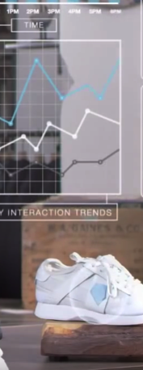
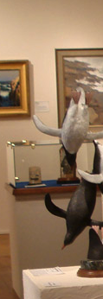
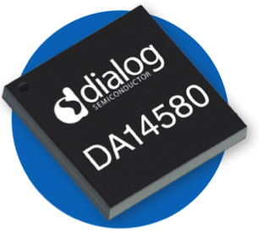
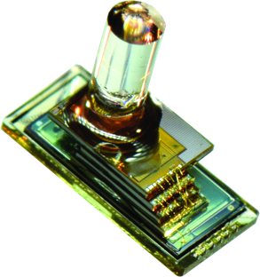
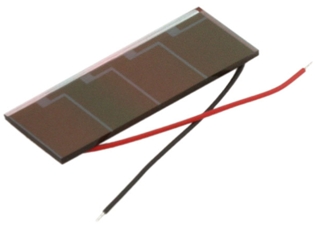
Several trends are making miniature and pervasive BLE beacons possible
Beacon Requirements are Simple
BLE Radios are Competing on Power
Energy-Harvesting can Eliminate Batteries
Smart Dust is the Ultimate Goal
TX only
Repeated payload
COTS chips at 4.9 mA TX
Minimize size
Potential for perpetual operation
Not yet accessible

Slide 5
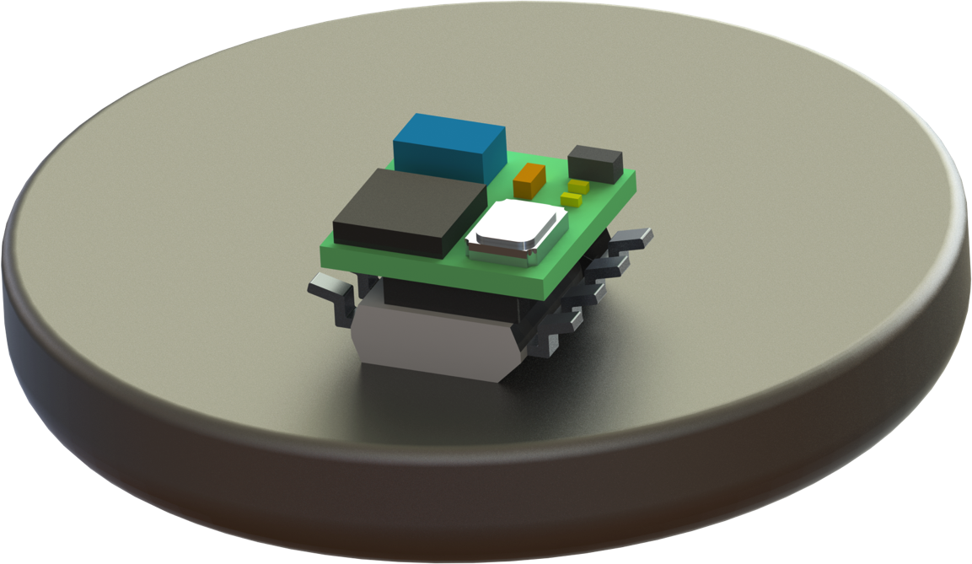
Cinamin: A BLE Beacon in Under 100 mm³
Three main systems
Solar Cell
Power Supply
BLE Radio
Radio/Antenna
0.60 mm
CR2032 Battery for scale
PCB
0.50 mm
Power Supply
0.80 mm
COTS parts
Solar Cell
1.50 mm
5 mm x 5 mm
≈85 mm³

Slide 6
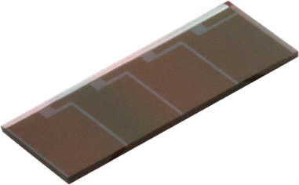
Operation: Charge capacitor to transmit a packet
Power Supply
BLE
Harvesting:
2.5-4.25 uW
Leakage:
≈1 uW
Power Supply P_{Q}:
60-990 nW
TX: 13-34 uJ
Sleep: 1-3 uW
Startup: 6-58 uJ

Slide 7
Between advertisements, is it better to sleep or shutoff and re-initialize?
In cold boot operation, we eliminate the P_{SLEEP} cost.
In sleep-mode operation, we eliminate the E_{STARTUP} cost.
(P_{HARVEST} − P_{LOSS} − P_{SLEEP}) · t_{period}
E_{STARTUP} + E_{ADV}
=
Incoming
Energy
Outgoing
Energy

Slide 8
At very low incoming energy levels, P_{SLEEP} dominates
(P_{HARVEST} − P_{LOSS} − P_{SLEEP}) · t_{period} = E_{STARTUP} + E_{ADV}
Notes:
Dialog DA14581: Cross: 5.8 uW
IcyTRX-65: Cross: 4.2 uW
Dialog DA14581: tperiod: 12 seconds
IcyTRX-65: tperiod: 6 seconds

Slide 9
How to increase P_{HARVEST}? Move the beacon closer to the light!
Irradiance ∝ 1/distance²

Slide 10
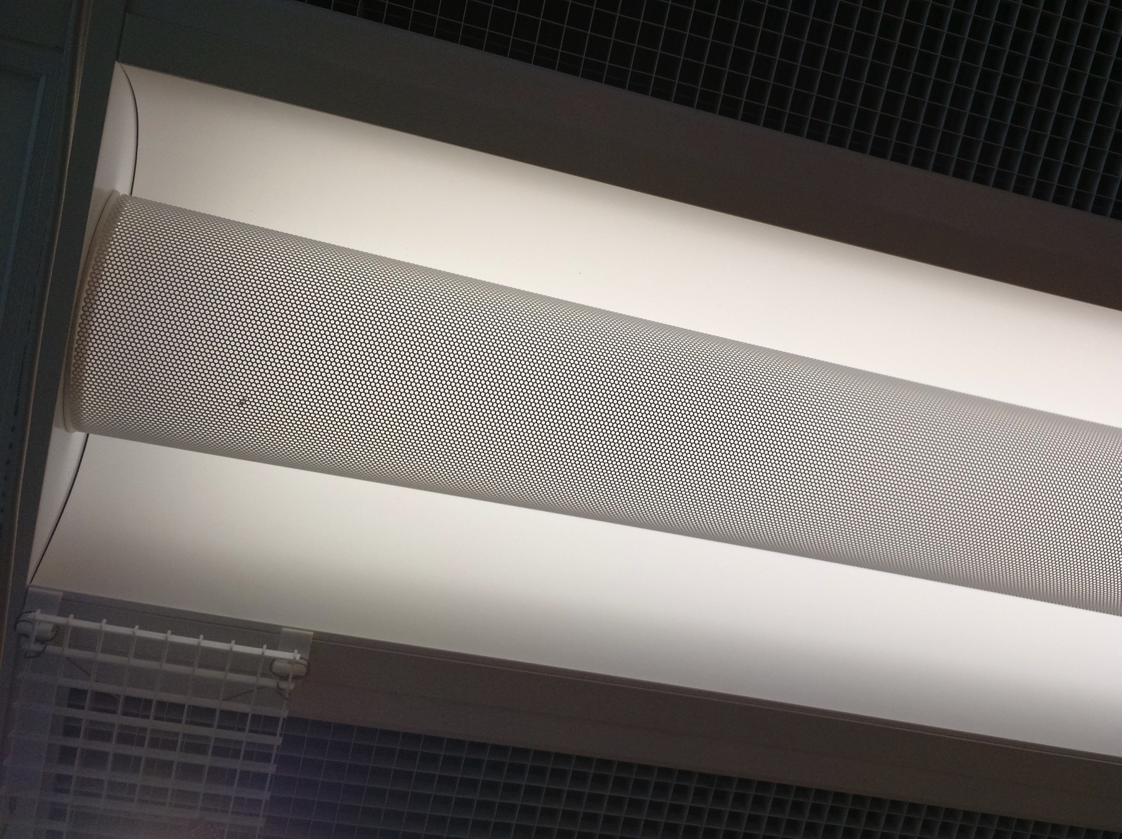
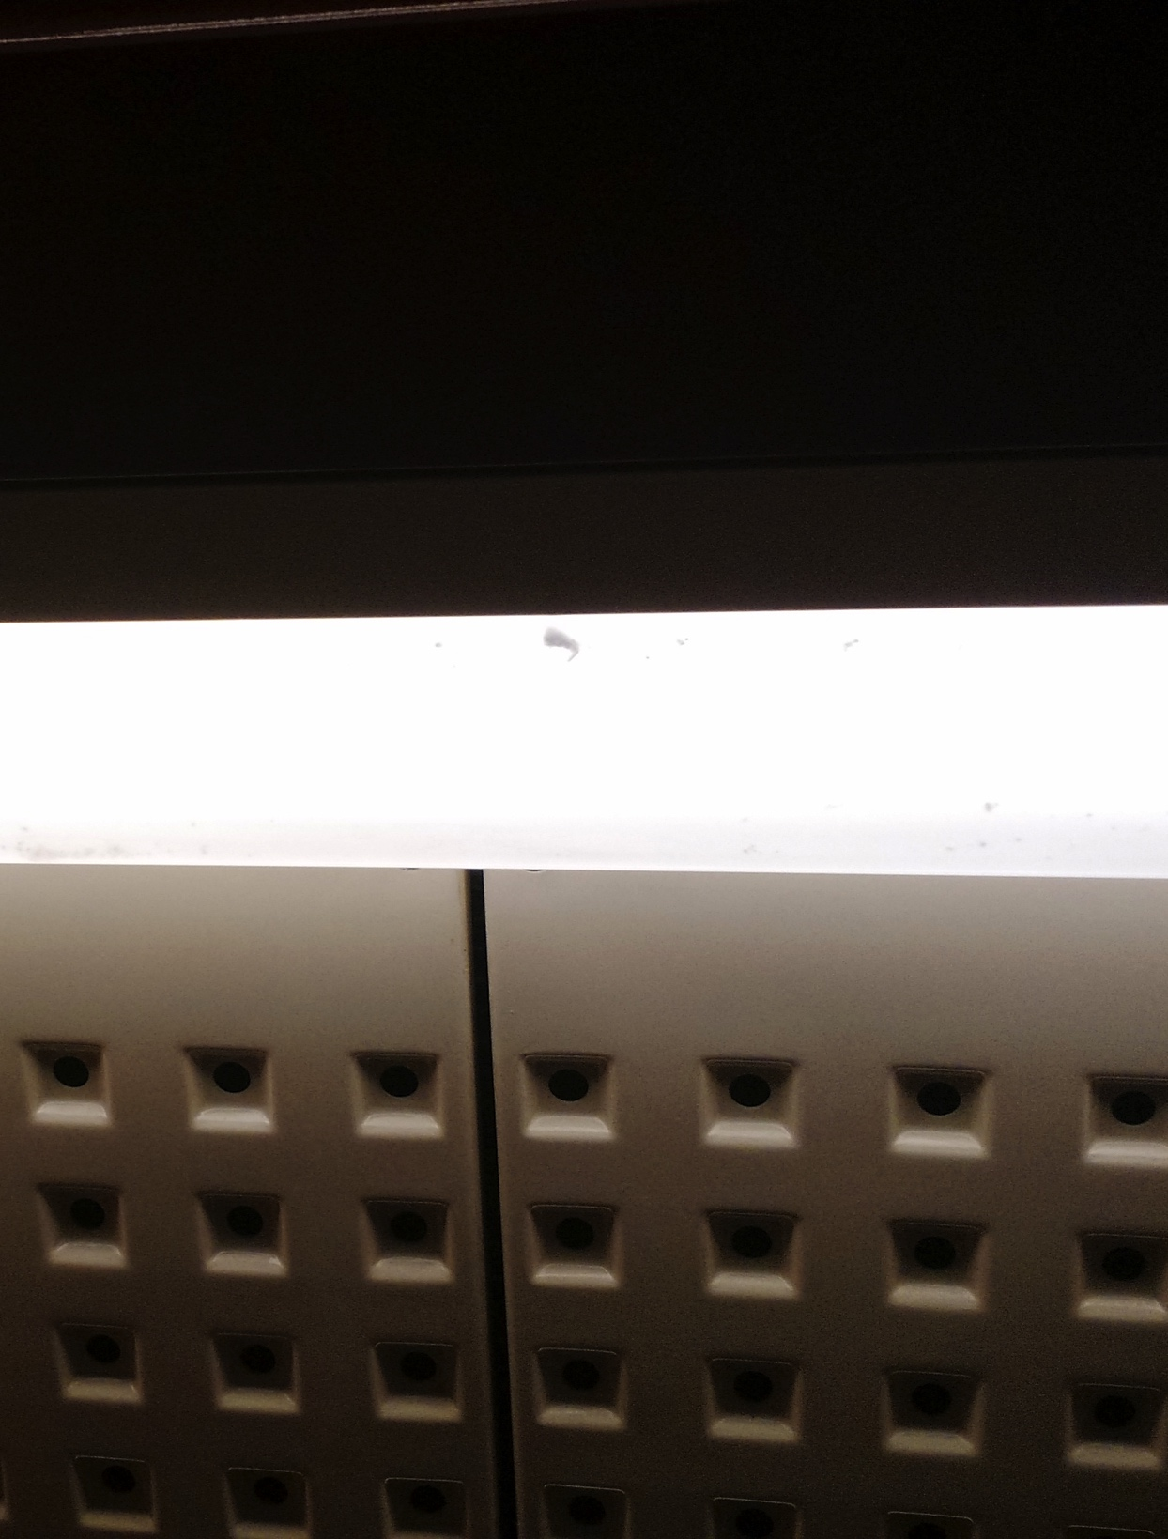
At 100 mm³, the beacons just look like dirt

Slide 11
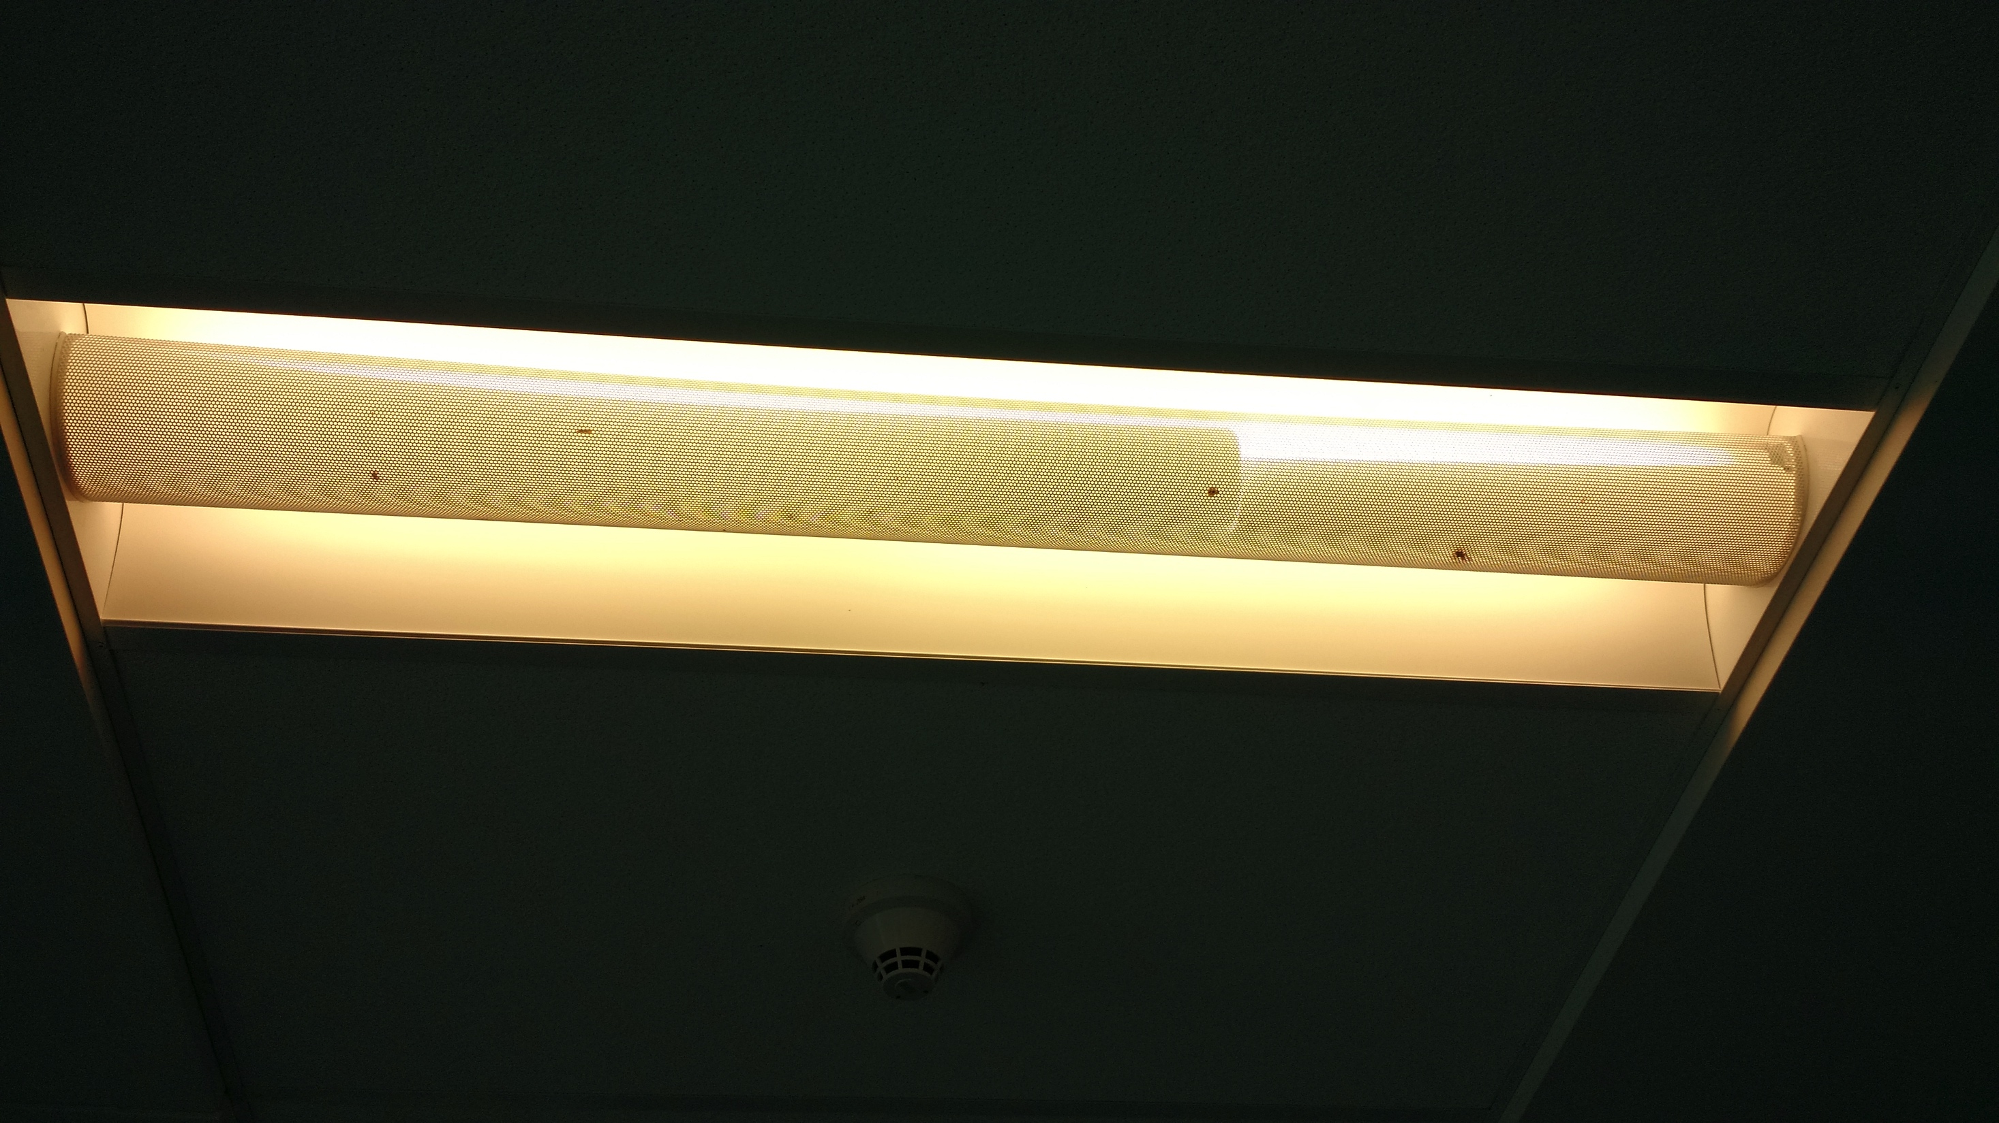
Or bugs

Slide 12
Let’s look further! What can we do with best-published technology?
Both very close to light
Best published results for Solar Cell, Supercap, and BLE Radio
Assume no losses
Notes:
Da14581: 0.15 pkts/second, IcyTRY-65: 0.5 pkts/second
Best: Aluminum gallium arsenide solar cells + graphene super capacitor + BLE transciever = 1.5 pkts/second, near light: 3.3 pkts/second
Theoretical:
- no leakage, all power tx: 7 pkts/second
- perfect solar cell: 28 pkt/second
- next to light: 60 pkt/second

Slide 13
Challenges in achieving this scale today
Need better power supply options
Match voltage thresholds to BLE chip being used
Minimize IC size and quiescent current
Automatically switch between cold-boot and sleep
Need a suitable solar panel
Ideally designed for indoor lighting
Difficult to find in this form factor
Will a COTS antenna actually work?
Can find small antennas, but have to violate keepout
Short range may be acceptable

Slide 14


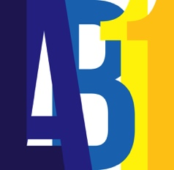
Conclusion
Cinamin is a design for a BLE beacon that can [likely] be built today
Better enable applications that blend the physical and digital worlds
Further work needed to explore the tradeoffs in operating modes and hardware designs
Brad Campbell
University of Michigan

Slide 15
Backup Slides

Slide 16
Best-published technologies
Aluminum gallium arsenide solar cells
“AlGaAs Photovoltaics for Indoor Energy Harvesting in mm-Scale Wireless Sensor Nodes”
Alan S. Teran, Jamie D. Phillips, et al.
Graphene supercapacitors
“Scalable fabrication of high-power graphene micro-supercapacitors for flexible and on-chip energy storage”
Maher F. El-Kady & Richard B. Kaner
BLE Transceiver
“13.2 A 3.7mW-RX 4.4mW-TX fully integrated Bluetooth Low-Energy/IEEE802.15.4/proprietary SoC with an ADPLL-based fast frequency offset compensation in 40nm CMOS”
Yao-Hong Liu, et al.
ISSCC 2015

